Slide 1

Enhancing Revenue through Data-Driven Insights: A Case Study on Bank Telemarketing Campaign
Utilizing Demographics & Response Patterns To Optimize Campaigns

Slide 2

CRISP-DM
Bank Telemarketing Campaign Analyst Data Using The Cross-industry Standard Process For Data Mining Methodology Followed Below Steps:-
Business Understanding
Data Understanding
Data Preparation
Modeling
Evaluation
Deployment

Slide 3
Business Understanding
01
Bank Telemarketing Campaign Overview
03
05
Recommendations
Goal: Identify influencing campaign success
The bank is conducting a telemarketing campaign for term deposits among existing customers to enhance revenue.
Term deposits are fixed investments with predetermined interest rates, fostering long-term customer relationships.
Increase Positive Response Rate: Use data analysis to identify patterns and factors influencing customer behavior, aiming to improve the effectiveness of the telemarketing campaign.
Optimize Marketing Strategy: Develop actionable insights from the campaign data to refine the bank's marketing efforts, focusing on the right customer segments, optimal timing, and appropriate communication channels.
Provide targeted recommendations for improving the positive response rate of the telemarketing campaign, ultimately driving increased revenue and fostering stronger customer relationships.
02
Objective of the Analysis
04
Scope of the Analysis
To enhance the bank's revenue by executing a cost-efficient telemarketing campaign aimed at promoting term deposits among existing customers. Term deposits, which are fixed investments with predetermined interest rates, are designed to build long-term customer relationships.
Customer Demographics: Understand the profiles of customers who are most likely to respond positively, including age, income, and account history.
Temporal Trends: Identify the best times and frequencies for contacting customers to maximize engagement and conversion.
Behavioral Insights: Explore customer behaviors and preferences that influence the decision to invest in term deposits.

Slide 4
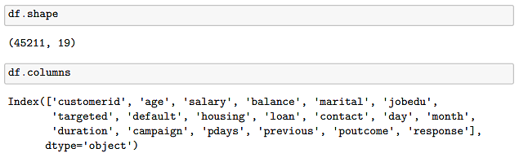
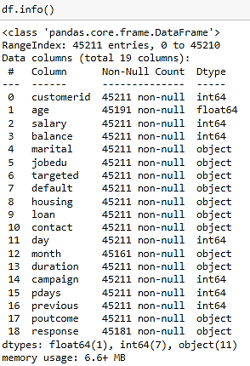
Data Understanding
01
Import Necessary Libraries
Data Handling and Visualization:
Libraries: NumPy, pandas, Matplotlib, Seaborn, SciPy, Missingno.
Purpose: Data manipulation, statistical analysis, and visualizations.
Preprocessing and Modeling:
Libraries: Scikit-learn, Statsmodels.
Purpose: Data encoding, splitting, model building (Logistic Regression), and evaluation.
02
Load the Dataset
Use Pandas to read the provided Excel file into a DataFrame.
Skip unnecessary headers to ensure accurate data loading.
03
Understand the Data Structure
Examine the shape, columns, and information of the dataset.
Utilize methods like `shape`, `columns`, and `info()` to gain insights into the dataset's characteristics.

Slide 5
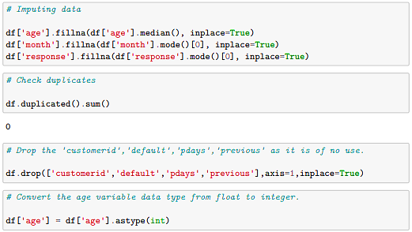
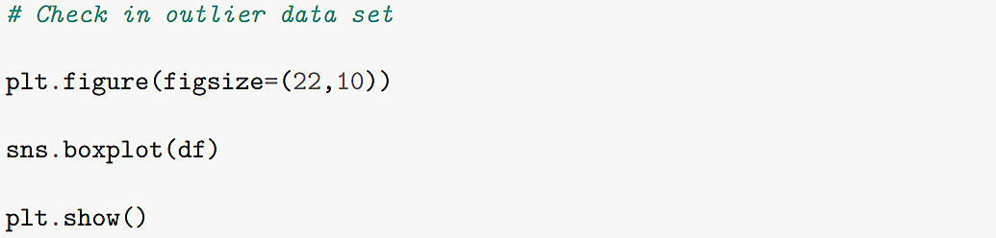
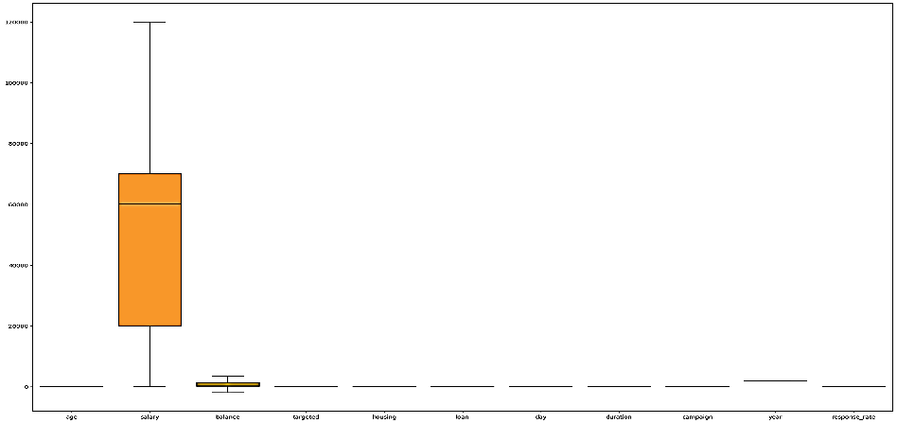
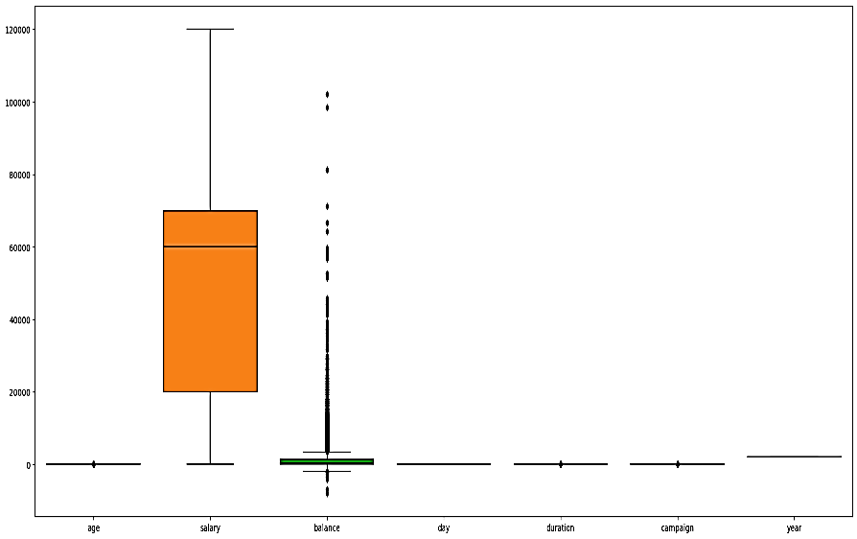
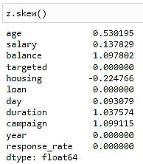
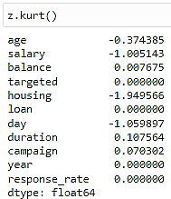
Data Preparation
01
Data Cleaning and Preprocessing
02
Exploratory Data Analysis (EDA)
03
Data Distribution Diagnostics
Handling missing values
Removing duplicates
Standardizing data formats
Identifying outliers
Visualizing data distributions
Feature engineering for model input
Using box plots and IQR methods.
Measure skewness to understand data asymmetry.
Assess kurtosis to evaluate data distribution "tailedness".

Slide 6
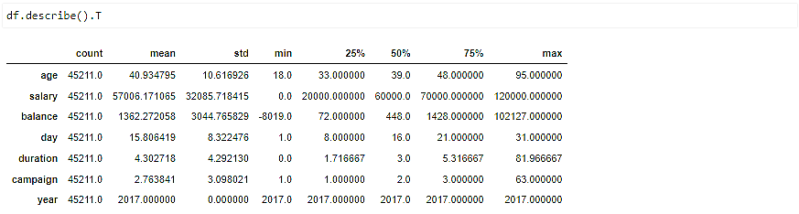
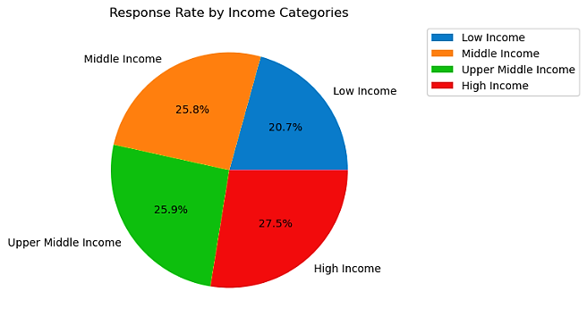
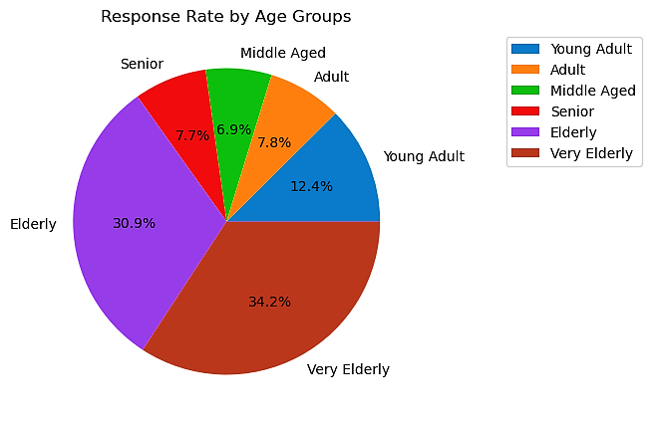
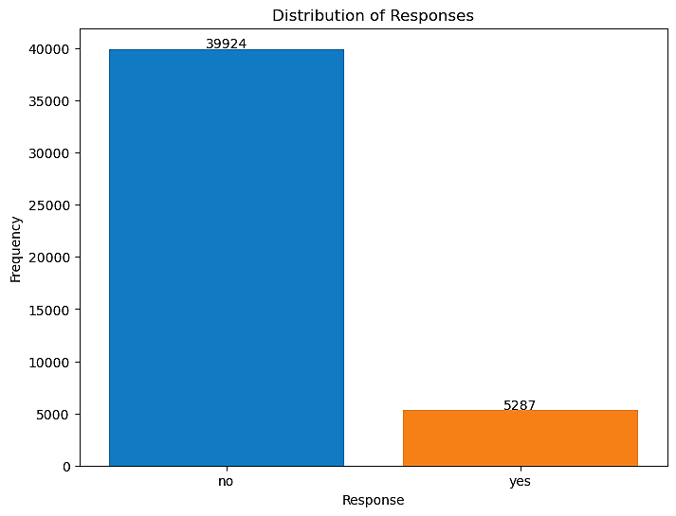
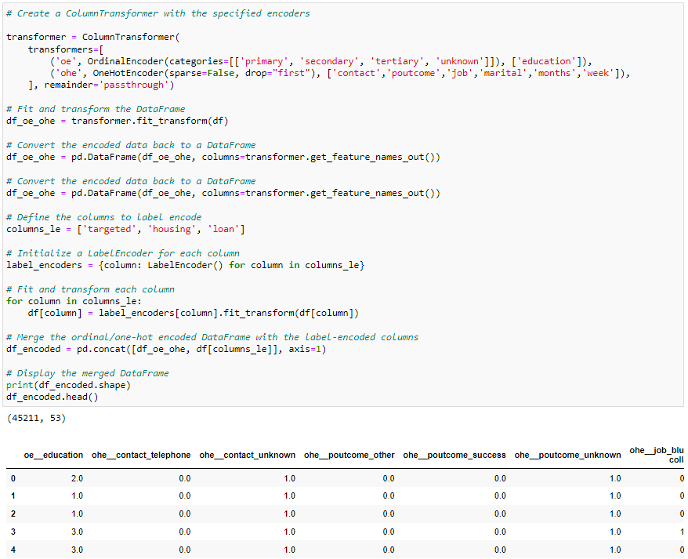
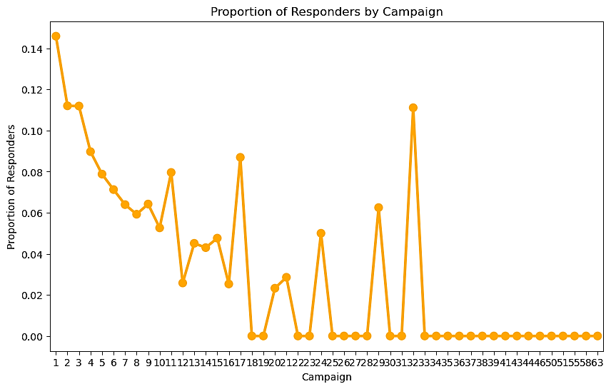
04
Descriptive Statistics
05
Data Transformation Techniques
Summary Statistics
Target Variable Distribution
Responders By Campaign
Creating new features for analysis.
Encoding categorical variables

Slide 7
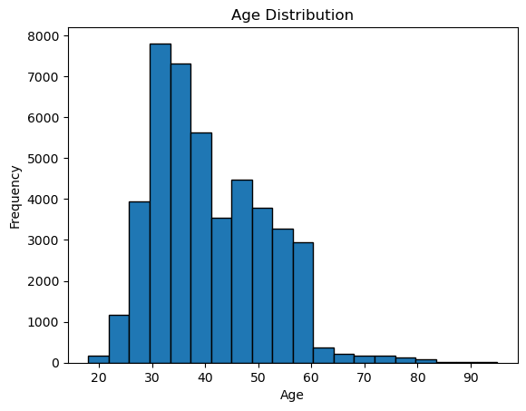
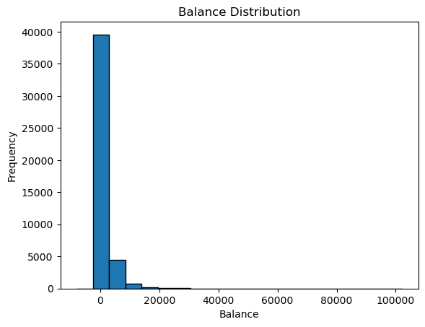
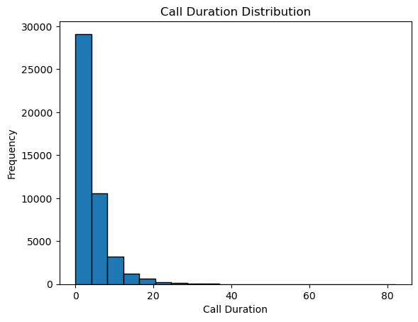
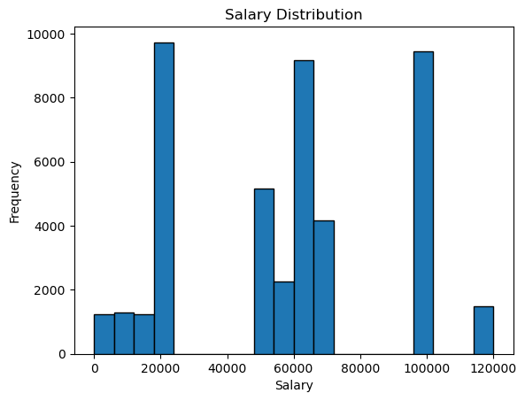
Modeling- Univariate, Bivariate & Categorical Analysis
Univariate Analysis: Individual Feature Analysis
01
Age Distribution
02
Balance Distribution
Right-skewed with median age 39 outliers above 70. Most customers are between 40-50 years old.
Left-skewed with median balance 448, outliers above 15000. Customers mostly have low balances.
03
Call Duration Distribution
04
Salary Distribution
Right-skewed with median call duration 3 minutes. Most calls are short.
Approximately symmetric around median salary 60000. Customers have moderate variability in salaries.

Slide 8
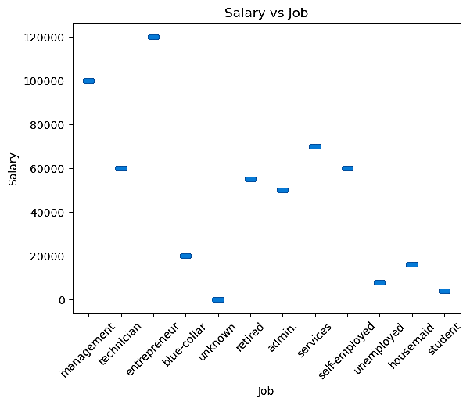
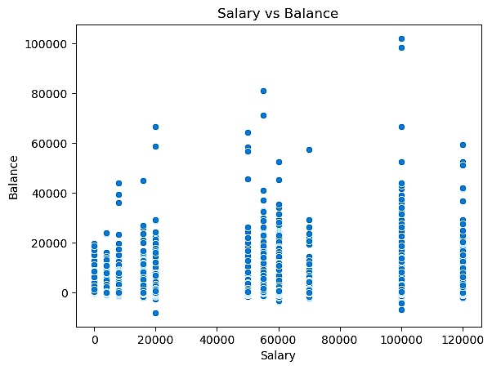
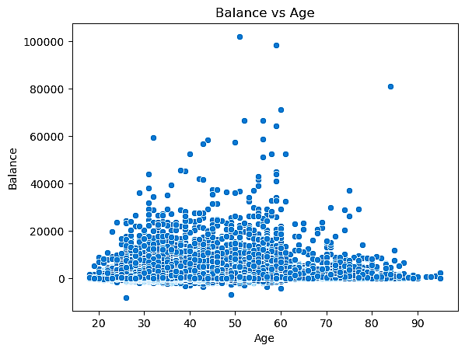
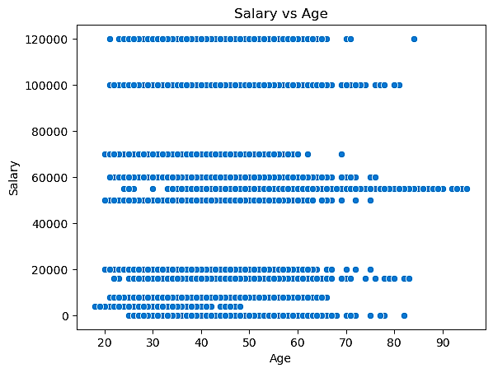
Bivariate Analysis: Exploring Relationships Between Variables
Customer Insights: Demographics and Financials
01
Marital Status vs Age
02
Salary vs Balance
Job type impacts salary, with skilled professionals driving profits. Focus on attracting and retaining top talent in high-paying job types to boost company performance.
Diverse saving behaviors exist, with no clear link between salary and account balance. Financial products should be individual saving patterns, not just income levels.
03
Balance vs Age
04
Salary vs Age
Customers aged 30-60 tend to have higher account balances. Target these age groups with savings and investment products to maximize engagement.
The scatter plot shows the relationship between age and salary. There appears to be no clear correlation between the two variables.

Slide 9
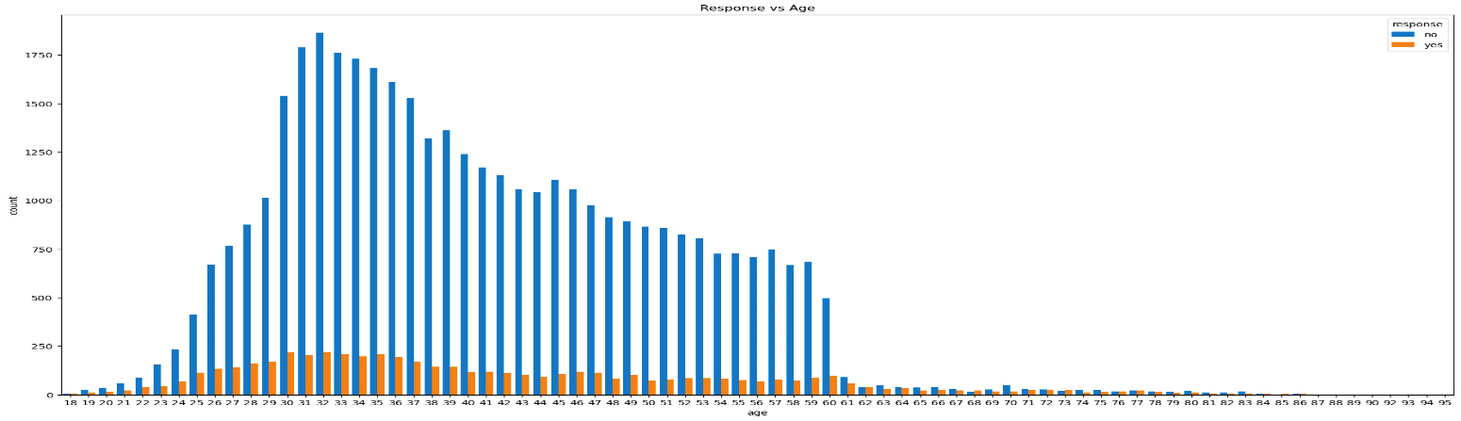
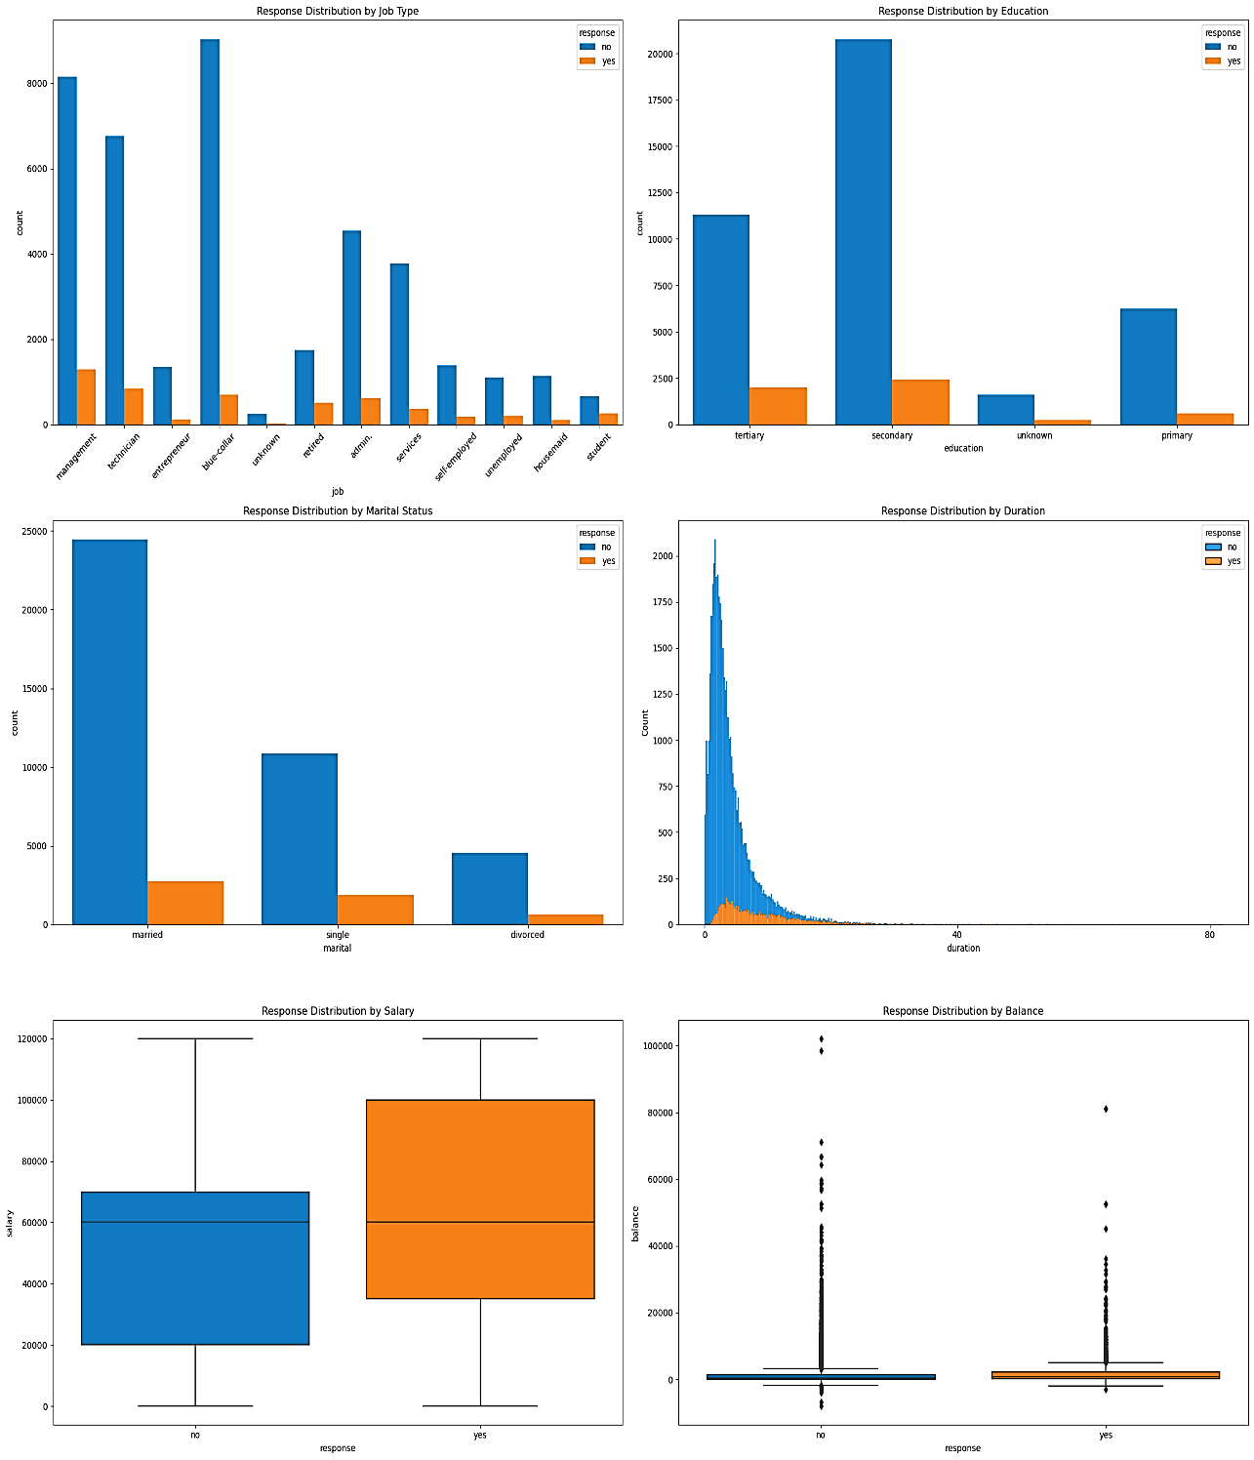
Data Insights: Response Patterns by Demographics and Finances
Response vs Age: Younger age groups dominate: Target with campaigns. Higher response rates among young: strong product affinity.
Response vs Job Type: "Blue-collar" employees are the most likely to be contacted, but they have a low response rate. Focus on benefits they'd appreciate, maybe offer incentives specific to their needs.
Response vs Education: Secondary education: clear & simple messaging needed. Segment by education: simple (secondary) vs. advanced (tertiary).
Response vs Marital Status: Married individuals: lower response rate. Target singles with lifestyle & financial benefits.
Response vs Duration: The distribution of call duration is skewed towards shorter calls. This could involve improved conversational skills, targeted questions, or value-added content.
Response vs Salary: Customers with higher salaries tend to have higher response rates. Emphasize value propositions that resonate with higher earners.
Response vs Balance: Balance distribution: mostly low, with high-balance outliers. Personalized messaging boosts engagement across balance segments.

Slide 10
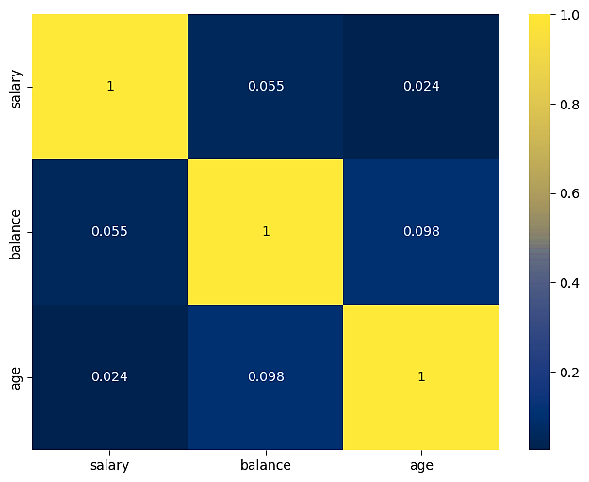
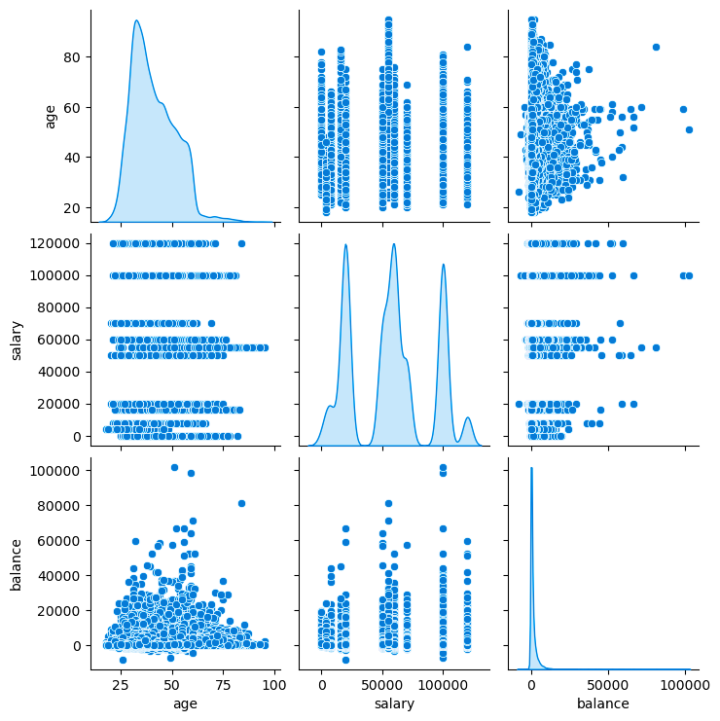
Feature Correlation Analysis: Identifying Relationships
Heatmap: Age, Salary & Balance
Pairplot: Age, Salary & Balance
The correlation matrix shows that there is a weak positive correlation between salary and balance, and age and balance. This suggests that people with higher salaries and older ages tend to have higher account balances, but the relationship is not very strong.
The distribution of age is skewed right, indicating that most customers are younger. This could inform targeting strategies. Additionally, salary and balance exhibit a weak positive correlation, suggesting that those with higher salaries tend to have higher account balances. This could be used to product offerings to different income levels.

Slide 11
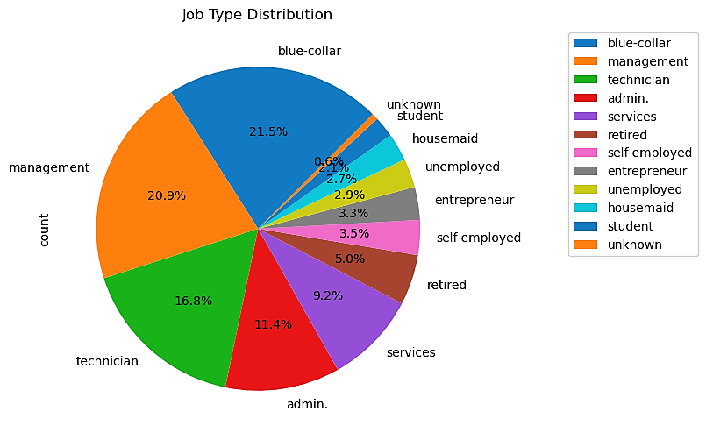
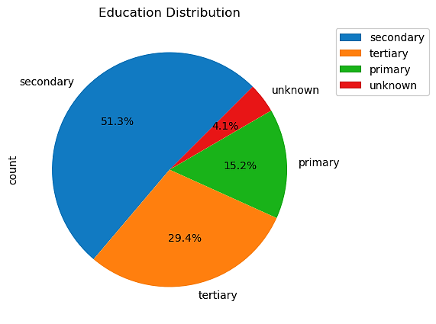
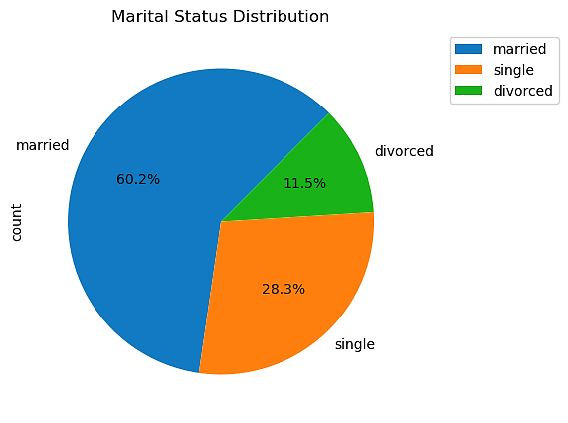
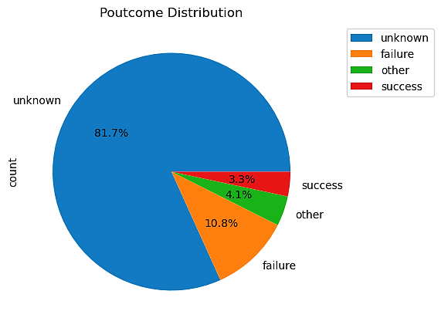
Categorical Analysis: Exploring Data Distribution and Patterns
Customer Demographics and Behaviors: A Visual Exploration of Bank Marketing Data
01
Job Type Distribution
02
Education Distribution
The most common job types in this dataset are blue-collar, management and technician, representing over 50% of the total. It is recommended to focus marketing efforts on these groups.
Majority of customers 51.3% have secondary education, offering targeted marketing opportunities. Leverage the 29.4% with tertiary education to offer premium solutions and drive revenue growth.
03
Marital Status Distribution
04
Poutcome Distribution
Majority of individuals are married 60.2% with significant portions single 28.3% and divorced 11.5%. Marital status segments to effectively target and engage with each group.
Majority of customers have unknown 81.7% with few successes 3.3% and more failures 10.8%. Investigate on customer poutcome to identify key drivers of success and areas for improvement.

Slide 12
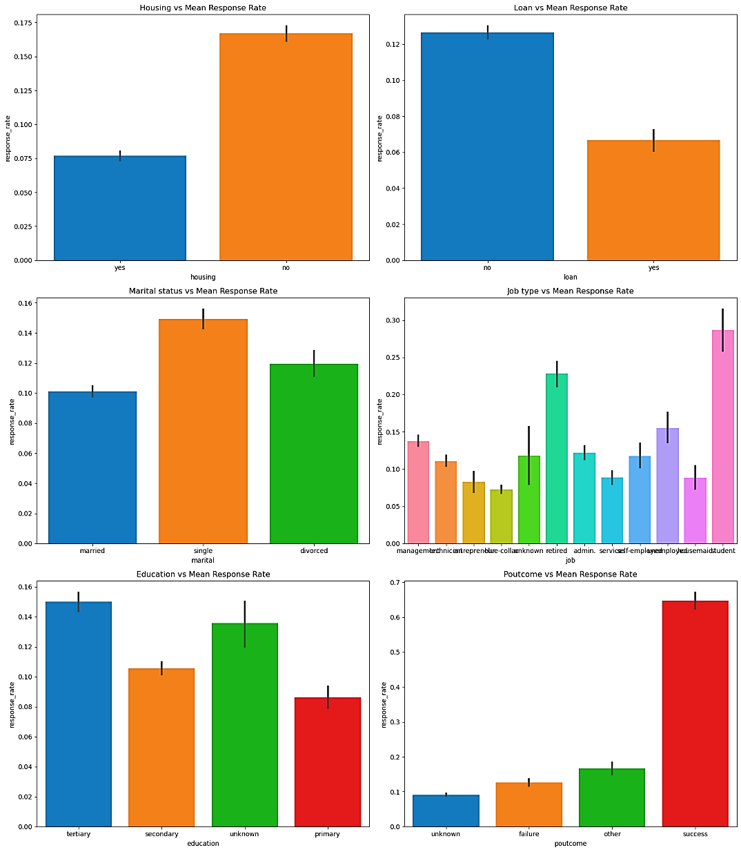

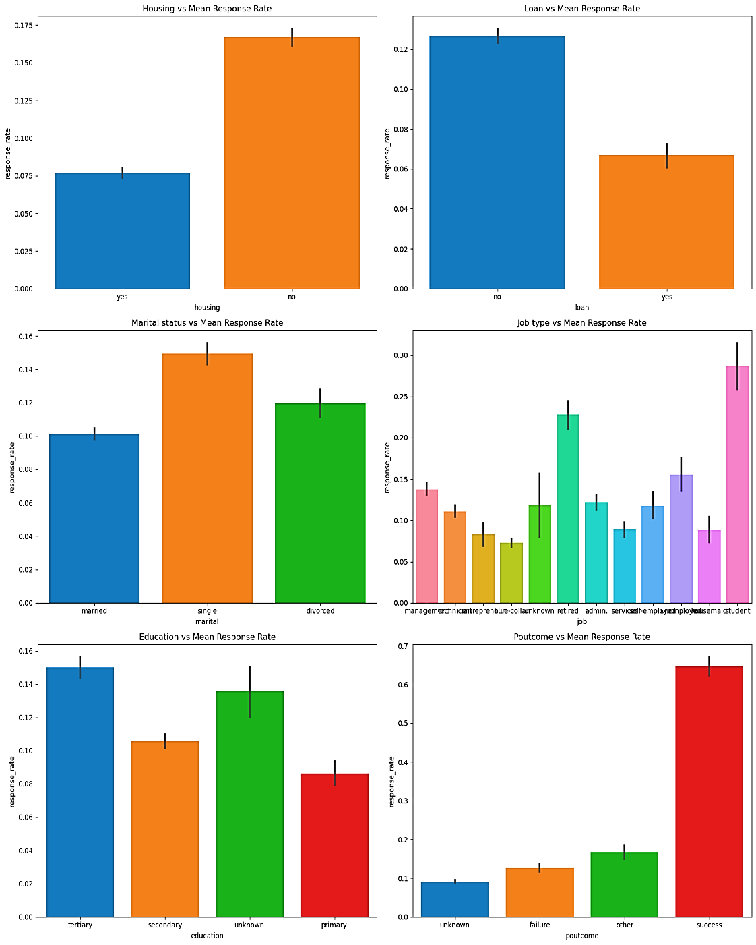
Demographic Insights: Average Response Rate
Housing vs Mean Response Rate: Customers with housing loans show higher response rates. Targeted marketing: personalized messages emphasizing product/service benefits.
Loan vs Mean Response Rate: Customers with loans show lower response rates, indicating a need for targeted approach. Adjust campaign messaging to address loan-holding customers' unique needs and concerns.
Marital status vs Mean Response Rate: Single customers are most responsive, followed by divorced and married. Target singles with financial security messages, married with family/home planning messages.
Job type vs Mean Response Rate: Students and retired individuals show highest response rates, followed by management and blue-collar workers. Target students with special offers, retired with financial independence messaging.
Education vs Mean Response Rate: Customers with tertiary education are most responsive, followed by secondary and others. Target tertiary-educated customers with premium products/services, leveraging their higher purchasing power.
Poutcome vs Mean Response Rate: Customers with previous successful campaign outcomes are significantly more likely to respond. Implement strategies to encourage repeat customers, such as loyalty programs or personalized offers.

Slide 13
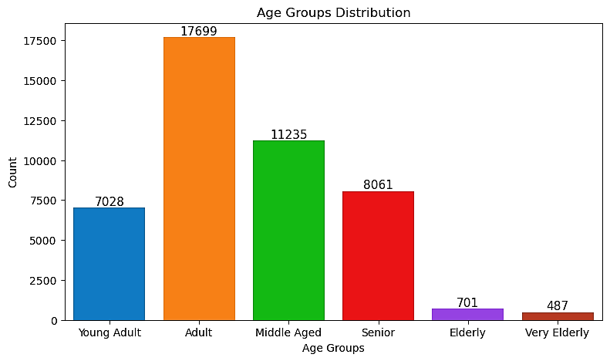
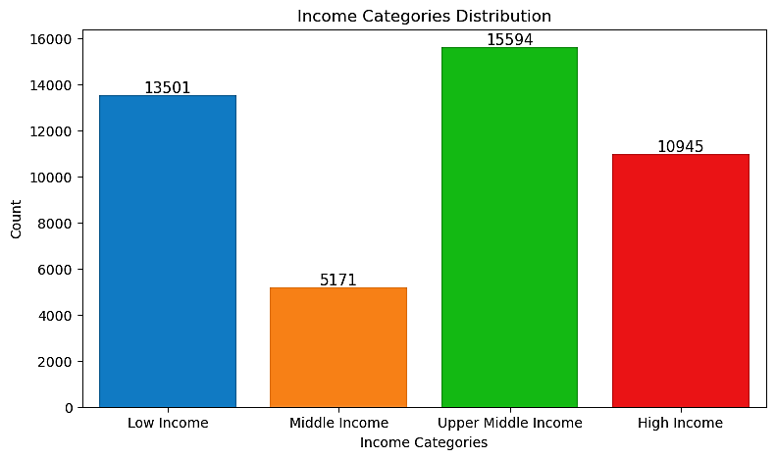

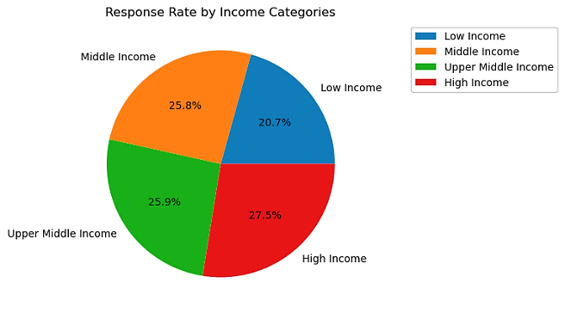
Evaluation
Customer Demographics:
01
Age Groups
02
Income Levels
The largest age group is "Adult" with 17699 members. The response rate is highest for the "Very Elderly" group with 34.2%. The lowest response rate is from middle-aged group with 6.9%.
The largest income levels is “Upper Middle income" with 15594. Customers with higher incomes tended to have better response rates. Lower-income groups showed less interest in term deposits.

Slide 14
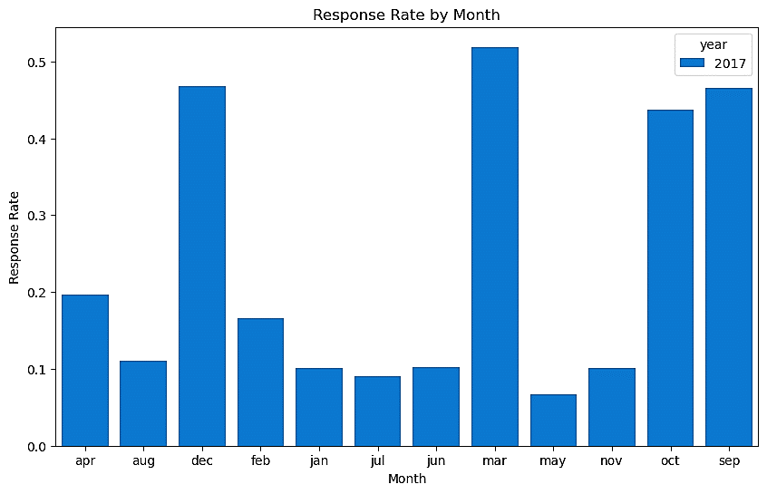
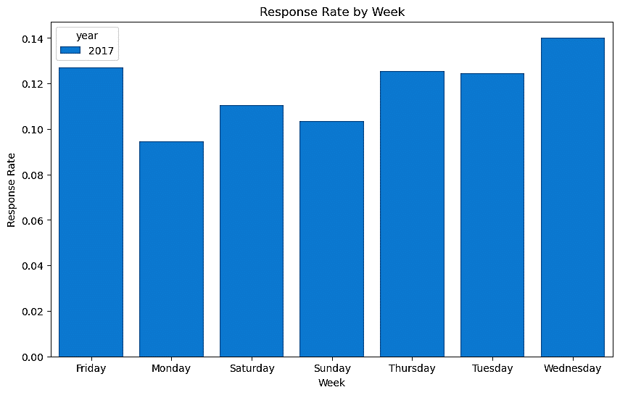
Timing of Campaigns:
01
Best Performing Months
02
Day of the Week
The analysis revealed that campaigns launched in March had the highest response rates, suggesting seasonality or external factors influencing customer behavior.
Campaigns conducted on specific weekdays Tuesday to Friday showed better engagement, indicating optimal days for future telemarketing efforts.

Slide 15
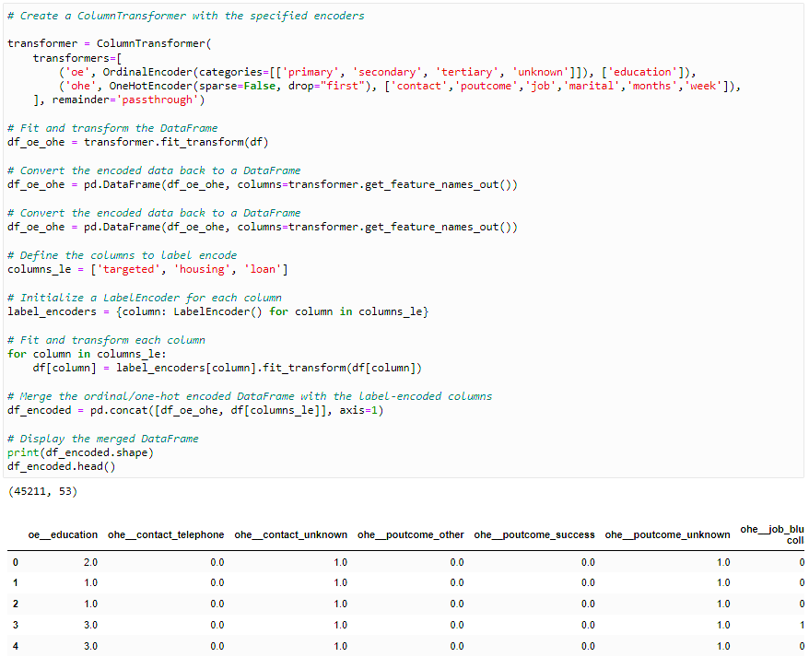
Communication Strategy & Campaign-Specific Insights:
01
Communication Strategy
Preferred Contact Methods: Contact through cellular phones was significantly more effective compared to other methods telephone. Personalized and direct approaches seem to engage customers better.
Impact of Call Duration: Longer call durations were positively correlated with successful outcomes, suggesting that more detailed conversations help in converting customers.
02
Campaign-Specific Insights
Number of Contacts: Customers who were contacted fewer times 1-2 times showed a higher conversion rate compared to those who were contacted more frequently. Over-contacting may lead to customer fatigue.
Time Between Campaigns : Customers who received campaigns with a shorter time gap less than 6 months had a higher response rate 55% compared to those with a longer time gap 6-12 months: 35%, more than 12 months: 20%.

Slide 16
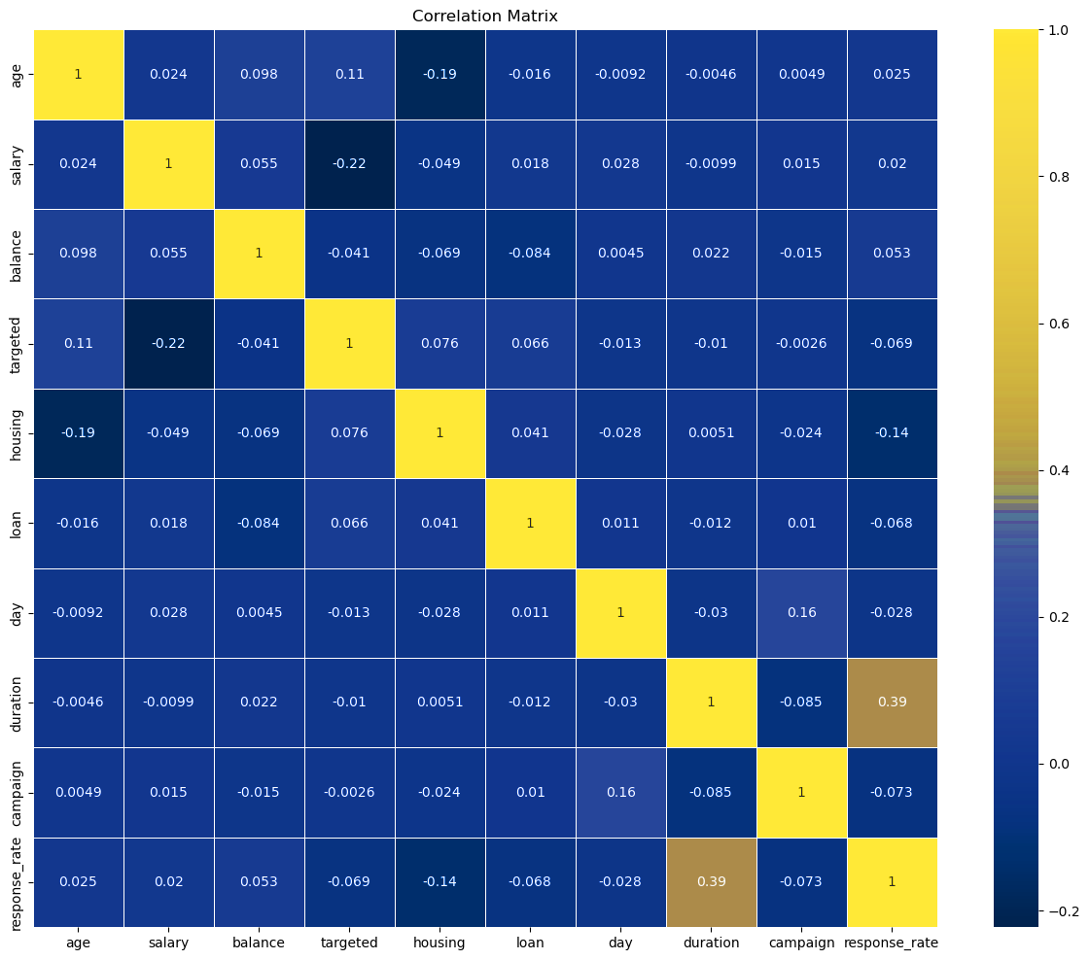
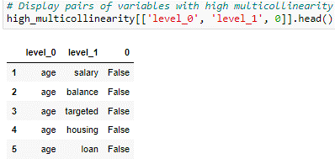
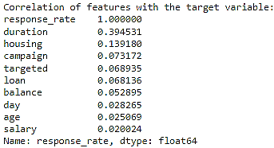
Correlation Analysis:
01
Strongest Correlating Features
Duration of Call: Highest correlation with positive response rates 0.39, suggesting longer calls increase the likelihood of a positive outcome.
Housing Status and Response Rate: Customers without housing loans had a higher response rate 0.14 correlation, which could indicate their availability of disposable income for term deposits.
02
Weak Correlations
Features like salary, age, and day of the month showed weak correlations with response rates, suggesting they are less impactful on the campaign's success.
03
Multicollinearity
No high correlations between independent variables, ensuring accurate coefficient estimates.
04
Influence Target Variable
The strongest predictor of the response rate is the duration of the campaign. Other variables with some influence include housing, campaign, targeted, loan, and balance.

Slide 17
Deployment- Targeted Marketing Campaigns
01
Customer Segmentation & Personalization
02
Campaign Execution
Demographic Focus: Prioritize middle-aged (31-50) and senior (51-70) customers.
Behavioral Targeting: Focus on customers with past positive responses and longer call durations.
Income-Based Strategy: Target high-income groups with premium products offer solutions for middle- and low-income groups.
Personalized Messaging: Customize messages to highlight relevant benefits.
Primary Channel: Prioritize cellular phone contacts.
Secondary Channels: Utilize email and SMS for broader reach.
Months: Focus on high-response months
Days: Launch on high-response days
03
Performance Monitoring & Feedback
04
Future Enhancements
Real-Time Monitoring: Track KPIs response rate, conversion rate and adjust strategies dynamically.
Feedback Loop: Collect insights from customers and sales agents to refine future campaigns.
Advanced Modeling: Integrate machine learning techniques for improved targeting.
Expand Data Sources: Incorporate external data economic indicators, credit history to enhance accuracy.
Iterative Refinement: Continuously update models with new data to optimize effectiveness.

Slide 18
Recommendations
01
Customer Demographics
03
Enhanced Communication Strategies
Age Group
18-30 years: Highlight digital convenience and short-term savings.
31-50 years: Focus on long-term planning and family-oriented services.
51-70 years: Emphasize retirement, trust, and personalized offerings.
Income Categories
High-Income: Offer premium services and exclusive investments.
Middle-Income: Provide a loan Categories like home/education loans.
Low-Income: Promote affordable options with flexible terms.
Preferred Channels
Prioritize Cellular Contacts: Continue focusing on cellular communication methods, which have a significantly higher success rate than other channels.
Multi-Channel Strategy: Integrate SMS, email, and social media to reach different customer segments effectively.
Personalization
Use Personalized Messaging: Address customers by name and loan offers based on their demographic profile and past behavior.
Dynamic Content: Use customer data to create dynamic content that resonates with their preferences.
02
Campaign Timing
04
Continuous Improvement
Seasonal Focus
Prioritize high-response months and key periods like tax season.
Day Optimization
Launch campaigns on high-response days Tuesday to Friday .
Data-Driven Adjustments
Monitor in real-time, use A/B testing, refine messaging.
Feedback Integration
Collect and use feedback from customers and agents.

Slide 19
THANKYOU!

